Slide 1



MITHABTEY - Career Seeker
Project code: 24-1-D-38
Presenters: Daniel Maman, Ben Avner Merigen
Supervisor: Dr. Naomi Unkelos Shpigel

Slide 2

The Problem Today
Many seek careers aligning with interests and skills.
Crucial for shaping future prospects.
Vast job opportunities, limited information, job offers change frequently And job world is changing rapidly.
There are professions that you do not know you may want
Notes:
דניאל

Slide 3
What is offered today?
Website | Advantages | Disadvantages
Truity | Offers a variety of personality tests. Provides career advice based on personality type. User-friendly interface with community forums. | Some resources require payment. Career advice based on generalizations. Overemphasis on personality.
CareerExplorer | Comprehensive career assessment. Detailed career profiles. Educational resources and articles. Salary calculator tool. | The matching process is very long. Salary estimates may vary in accuracy. Some features require payment.
Websites in Israel Alljobs, Jobnet, Jobmaster, Avodata | Large databases of job listings. User-friendly interfaces. Resources and tips for job seekers. | Do not provide a good solution for finding a job based on character traits and preferences. Users must find the job that best suits them based on basic search and filters.
Notes:
דניאל

Slide 4


Interview With IRIT Hommsi Managed facebook group 'Mithabtey Miktzoa'
This Facebook community was established in 2016 and aims to reveal diverse job worlds
Facebook group with 40,000 members.
Interviews are conducted with professionals.
A large database of unique information about professions.
Link: https://www.facebook.com/groups/612789808874188
Notes:
בן

Slide 5
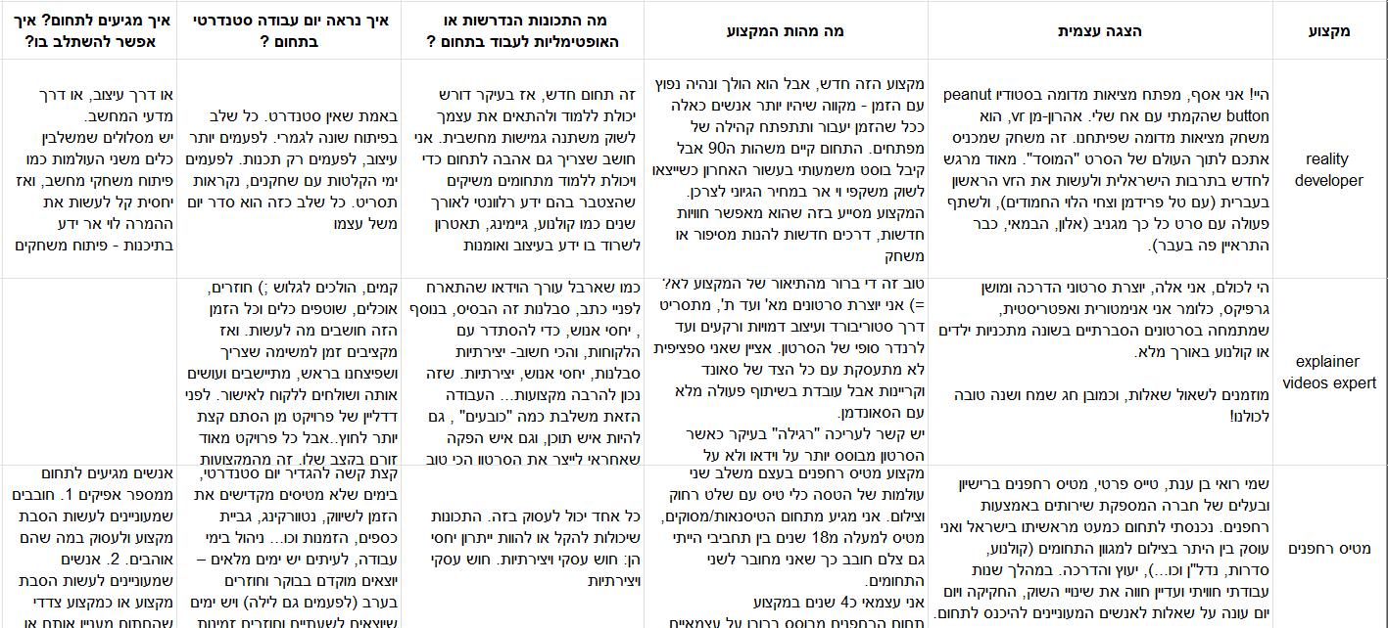
Job information file example UNOrganized Excel
Unstructured Excel file with profession data from Irit
Lacks organized pattern for efficient data mining
Extract RAMAK traits characterizing each profession
Notes:
בן

Slide 6


Personality traits model
5
BIG FIVE MODEL
HOlland
Developed in the 1980s.
Five broad dimensions that describe human personality (OCEAN): Openness to Experience, Conscientiousness, Extraversion, Agreeableness, and Neuroticism.
The concept was developed in 1950 and the employment approach was developed in 2008 by James Rounds, Ya Liao.
Based on 6 character traits (RIASEC): Realistic, Investigative, Artistic, Social, Enterprising and Conventional
RAMAK
Developed in 2011 by Elhanan Meir.
Based on Anne Roe's theory.
Person is characterized by 8 areas: Business, Organization, General culture, Service, Arts and Entertainment, Outdoor, Science, Technology.
Notes:
בן
חשוב להדגיש: סקירה על אן רו והתאוריה שלה. היא הודחקה לחלוטין בגלל היותה אישה, ולמזלנו אלחנן מאיר תרגם את השאלון שפיתחה, וכך בישראל השאלון הזה הופץ BigFive: psychological model that describes five broad dimensions of personality, These traits are believed to be relatively stable throughout an individual's lifetime HOLLAND: Some refer to these as Holland Codes or RIASEC. People of the same personality type working together create a work environment that fits their type

Slide 7

Interview With RANAN HASS
The selection in ramak questionnaire
Disadvantages of Big Five:
Theoretical model, impractical for our website's purposes. Disadvantages of Holland questionnaire :
Outdated, professions may not align with modern job markets.
Recommendation: RAMAK Questionnaire - It is precisely adapted to the world of employment.
- Uses 3 levels to describe each trait.
- Valid, proven.
- Questionnaire up-to-date.
Business Value based HR specialist
Innovator
Chief Psychologist at PValueHR
Notes:
דניאל

Slide 8
project goals
01
02
04
03
05
organization
Admin control
Organize the data from the Facebook group
Control over the jobs in the DB, users, forums and more
Users character traits
Jobs character traits
Analysis user character traits in the best way today
Analysis character traits required for jobs
genetic algorithm
Maximum matching between character traits and possible jobs
Notes:
דניאל
לסדר את כל המידע שיש בקבוצת הפייסבוק
הנגשת קבוצת הפייסבוק ואי הסדר לאתר מסודר, נוח ונגיש למשתמשים.
ניתוח תכונות אופי של משתמש בצורה הטובה ביותר
ניתוח תכונות אופי הנדרשות למקצוע
התאמה מקסימלית בין תכונות אופי למקצועות אפשריים באמצעות אלגוריתם גנטי – לוודא תרגום של האנגלית
לתת למנהל יכולות שליטה על המקצועות באתר, משתמשים, פורומים והעלאת פוסטים
H

Slide 9


Genetic Algorithm Matching between user`s traits And job`s traits
Optimization algorithms inspired by natural selection.
Used for finding optimal solutions to complex problems.
Mimics evolution with processes like selection, crossover, and mutation.
Individuals represented as sets of parameters or genes.
Evaluated using fitness function.
Notes:
בן

Slide 10
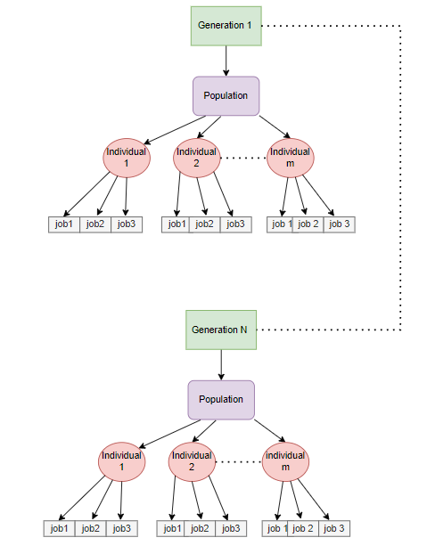
Genetic Algorithm generation, population, INDIVIDUAL
Individual is a list of 3 random professions.
The population will be a list of predetermined size of individuals.
In each generation we have a new list of population (some of them remain from the previous generation).
Notes:
בן

Slide 11
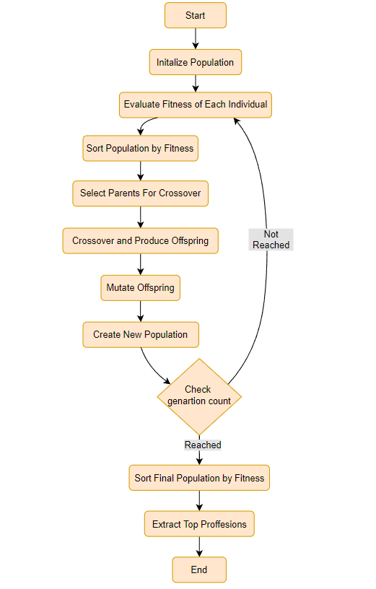
Genetic Algorithm Flow
The 3 main processes in the genetic algorithm:
Random initialization
Loop that repeats N generations
Finishing and getting the best results.
Notes:
דניאל

Slide 12
Genetic Algorithm Inside the loop
Fitness - Representing how well an individual suit to user.
Selection - Roulette wheel: more suitable individuals will be chosen with a higher probability- select 2 parents.
Crossover - Exchange between 2 parents, in split point to create new childrens.
Mutate - Changing an individual's job randomly.
Notes:
דניאל

Slide 13
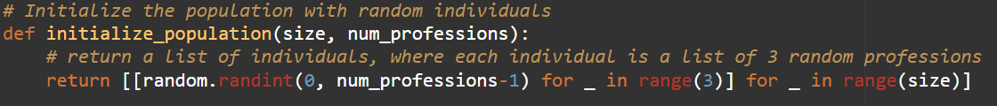

Genetic Algorithm Random initialization
We will define a list of initial population.
The population size will be a predetermined number.
Each individual in the list will consist of 3 random professions.
Notes:
אתחול ראשוני רנדומלי
לולאה שחוזרת N דורות
סיום וקבלת התוצאות הטובות ביותר

Slide 14
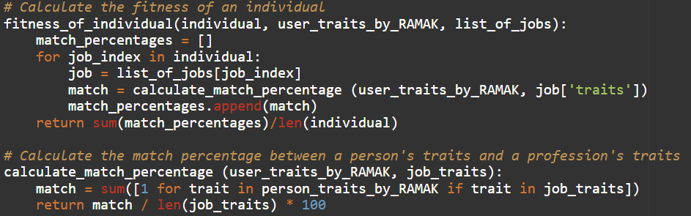
Genetic Algorithm Fitness
Represents how well an individual in the population solves the problem.
The function calculates the fitness of each individual by measuring the match percentage between the person's traits and the traits required for each of the professions in the individual's list.
This fitness score guides the selection process in the genetic algorithm, favoring individuals with higher fitness scores.
Notes:
מידול של Fitness function המטרה - כמה תכונות מהמקצוע נמצאות אצלי Trait U = 1 Trait P = 1 2
=> בדוגמא למעלה יש לי תכונה אחת מתאימה מתוך 2 ולכן אני דומה ב 50 אחוז

Slide 15
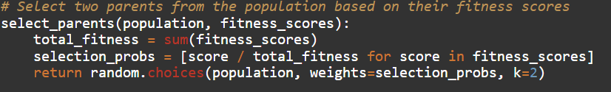
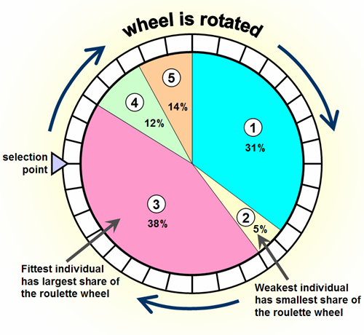
Genetic Algorithm Selection
Stochastically select from one generation to create the basis of the next generation.
The requirement is that the fittest individuals have a greater chance of survival than weaker ones.
Implements selection using a method called roulette wheel selection.
Notes:
החלק הבסיסי בתהליך הבחירה הוא בחירה סטוכסטית מדור אחד כדי ליצור את הבסיס לדור הבא. הדרישה היא שלאנשים הכי חזקים יש סיכוי גדול יותר לשרוד מאשר לחלשים יותר. זה משכפל את הטבע בכך שלפרטים בכושר יש סיכוי טוב יותר להישרדות והם ימשיכו להרכיב את מאגר ההזדווגות לדור הבא. אנשים חלשים יותר אינם חסרי סיכוי. בטבע לאנשים כאלה יש קידוד גנטי שעשוי להיות שימושי לדורות הבאים.

Slide 16
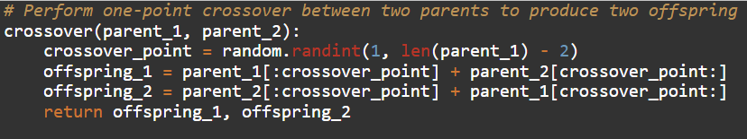
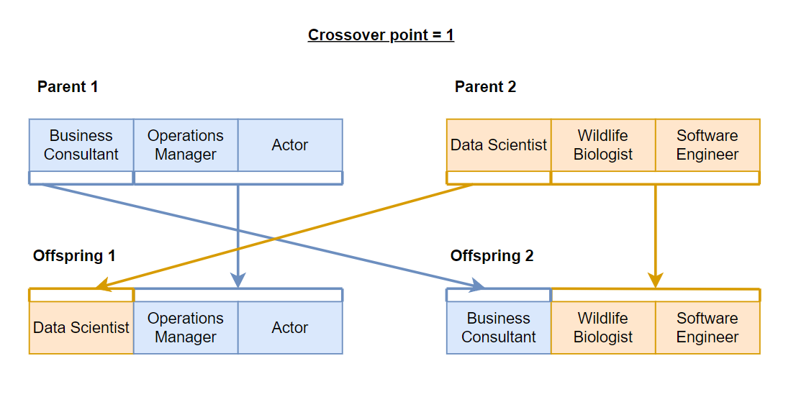
Genetic Algorithm Crossover
Randomly selects crossover point along parents' ‘chromosomes’.
Creates two offspring by combining parents' genetic information
The function randomly selects a crossover point.
This process helps maintain genetic diversity in the population and can lead to the discovery of new, potentially better solutions to the problem.
Notes:
מידול של Crossover

Slide 17
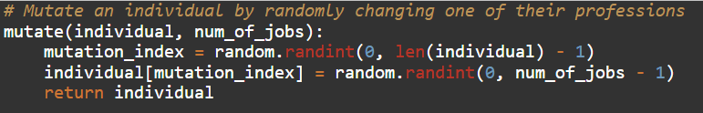
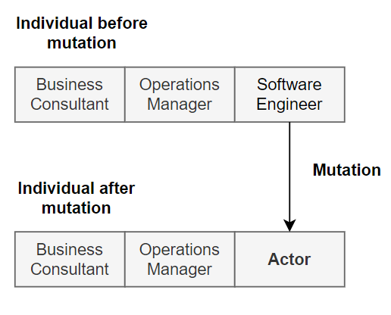
Genetic Algorithm Mutation
The function implements mutation by randomly changing one of the professions in an individual.
Ensures each generation has genetic diversity.
Crucial for exploring a wide range of potential solutions and finding optimal/near-optimal solutions.
Notes:
מידול של Mutation

Slide 18
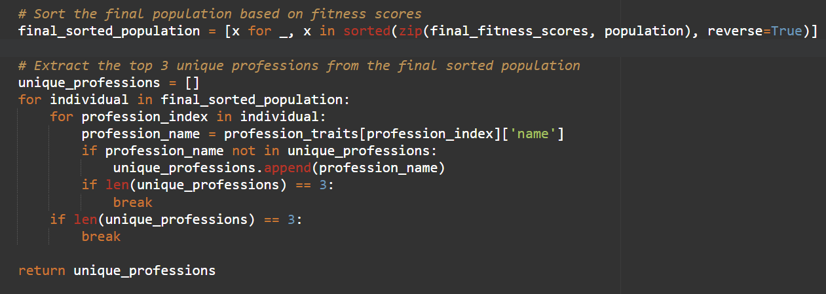
Genetic Algorithm Extract most suit professions
We will take the last population created and sort it by match percentage from largest to smallest.
We will take the first three most suitable professions that are different from each other.

Slide 19
Requirements
Functional requirements
Non-functional requirements
User Account Management: Registration, Login, Edit Profile
Job Search and Information: Search jobs by field Receive job information Save favorite job listings
Genetic Algorithm: Match user traits to jobs
Questionnaires and Feedback: Answer RAMAK questionnaire Give feedback on algorithm results
Job Management: Admin can add/delete/edit jobs Alerts for new jobs
Usability: Easy navigation and clear instructions Authentication: Secure login with username and password Management: Admin-exclusive job management Scalability: Handles large user base and job listings Security: Secure storage and transmission of user data Compatibility: Works on various browsers/devices Maintainability: Easy to update with clear documentation Performance: Quick loading and responsive Accessibility: Accommodates people with disabilities
Notes:
בן

Slide 20
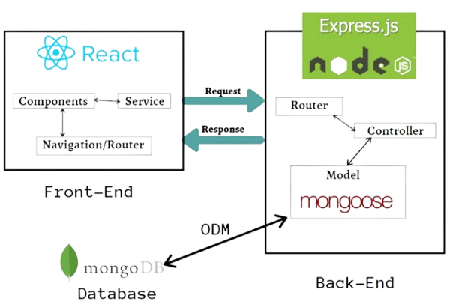




System architecture
MERN
React
Typescript
Front-End
Program language
Node.js
Mongodb
Back-End
NoSQL DataBase
Notes:
דניאל

Slide 21
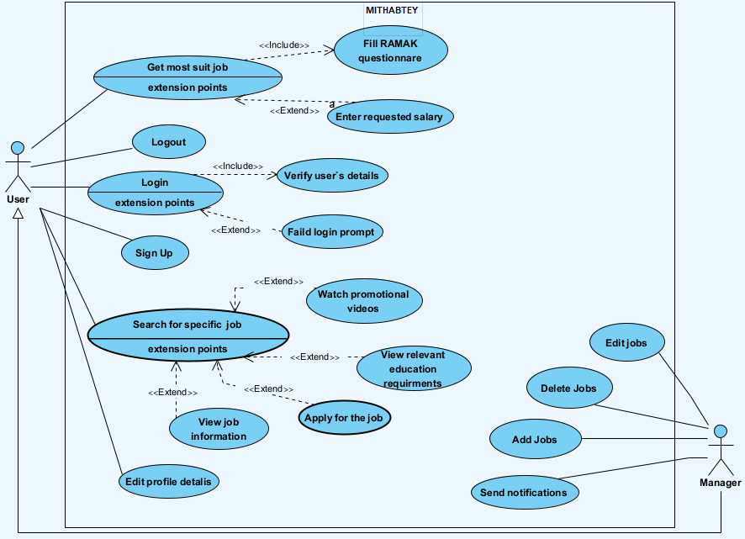

Architecture Use case
Notes:
בן

Slide 22
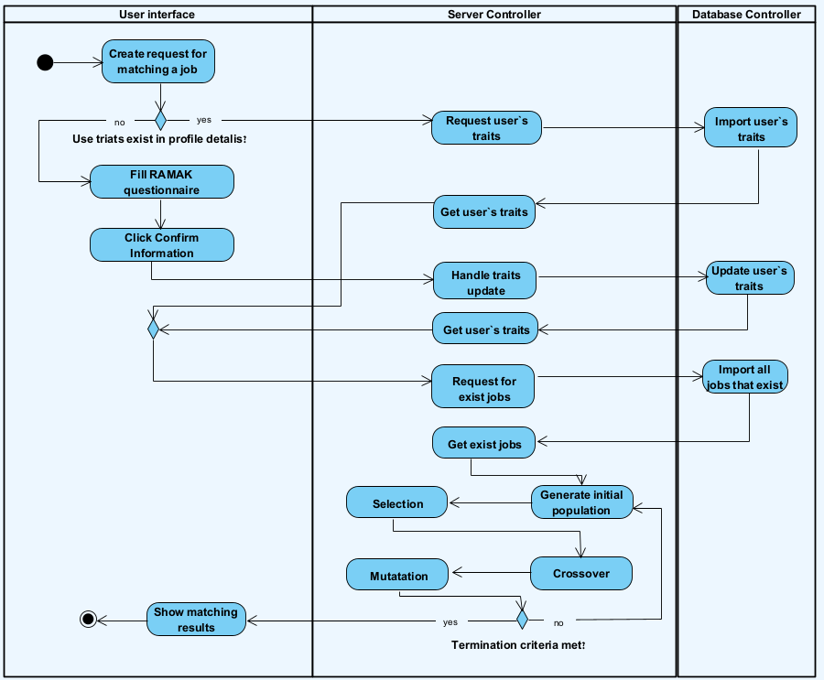

Architecture Activity Diagram Searching job
Notes:
בן

Slide 23





Testing plan
Registration and login:
User Registration with valid user information
User Login
Admin Login with appropriate permissions
Job Search:
Search Jobs by field
Editing:
Edit user profile information
Add Job by admin
Delete Job by admin
Edit Job by admin
RAMAK Questionnaire:
Answer Questionnaire (store responses)
Cannot submit until the user answers all the questions.
Notes:
בן

Slide 24


Project metrics
Comprehensive Evaluation System
Targets and Continuous Improvement
Intermittent User Surveys:
Surveys to evaluate satisfaction with algorithm answers and RAMAK questionnaire.
Genetic Algorithm Validation:
Verification of results with people who are works in the jobs.
Analysis the final answers with employment psychologists.
Follow up over time:
Updates from users on career progression.
User Growth Targets:
Anticipate 30% increase in user registrations within the first three months.
Surveys and Polls:
Create surveys and polls within the 'MITHABTEY' Facebook group. At least 60% of respondents to recommend the site.
80% of users want to reuse the site for career guidance.
Notes:
בן

Slide 25
The challenges during the project
01
02
03
04
Extracting DATA
Psychological research
The data is not well organized on Facebook.
Finding the ideal questionnaire. Analysis character traits of jobs.
Working with client
Development tools
Done for the first time, requires patience and mental flexibility.
The tools can still change until the development process.
Notes:
דניאל
חילוץ מידע - המידע לא מסודר ואין תבנית קבועה לחיפוש בפייסבוק.
מחקר - מציאת השאלון האידיאלי. ניתוח פסיכולוגי של אופי המתאים למקצועות.
עבודה מול לקוח - נעשה לראשונה, דורש סבלנות והצבת גבולות.
כלי פיתוח- מה שתכננו לא בהכרח ייצא לפועל עקב אילוצי מערכת וכד'

Slide 26


THANKS for listening!
QUESTIONS ?
https://github.com/MamanDaniel/MITHABTEY-CareerSeekers
Prototype

Slide 27
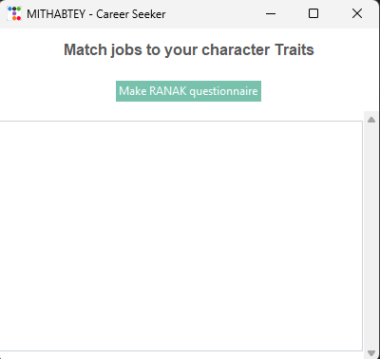
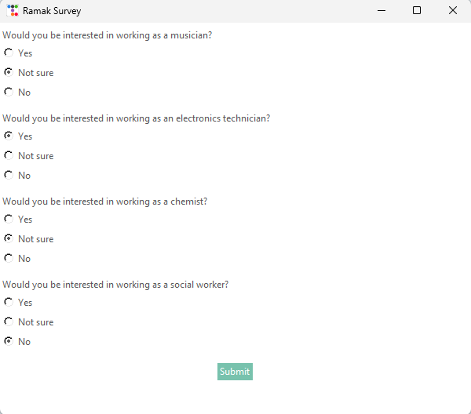
Prototype
Make RANAK questionnaire

Slide 28
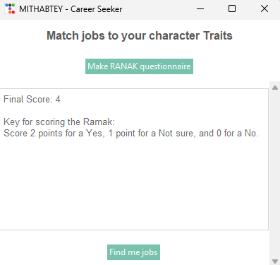
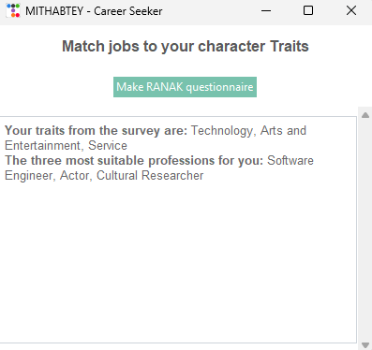
Prototype
Find me jobs

